Slide 1
Plutarch Parallel Lives - Refactored
Anargyros Katsoulieris, 402
Konstantinos Leventos, 405

Slide 2
Contents
Introduction
God Class
Testing
Code Style
Summarising

Slide 3
Introduction
What we did:
We made the UML.
We made the Sequence Diagrams.
We detected the Weaknesses.
With them, we decided on what to refactor, and how to alter the rest of the code.

Slide 4
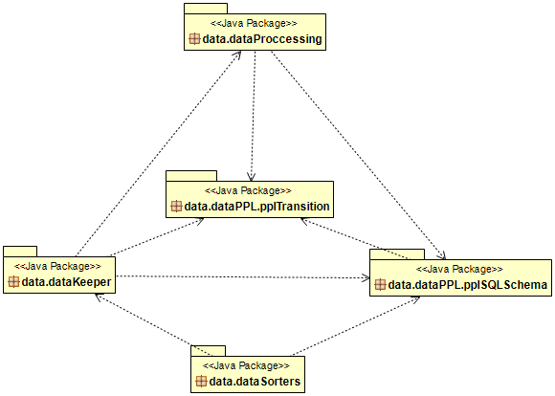
Introduction – Data

Slide 5
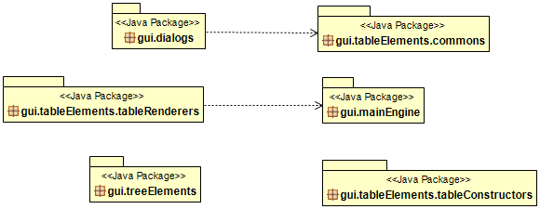
Introduction – Gui

Slide 6
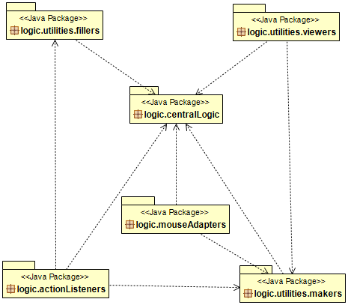
Introduction – Logic

Slide 7
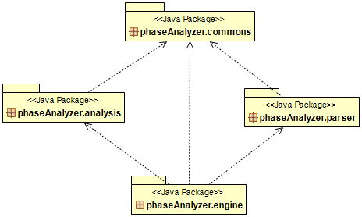
Introduction – Phases

Slide 8
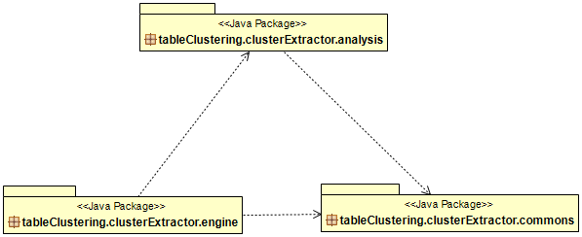
Introduction – Tables

Slide 9
God Class
God Class:
We split it, by removing all logic from it, moving it to the Logic Package.
We wrapped all logic with abstract classes and interfaces, allowing only their factories to be public.

Slide 10
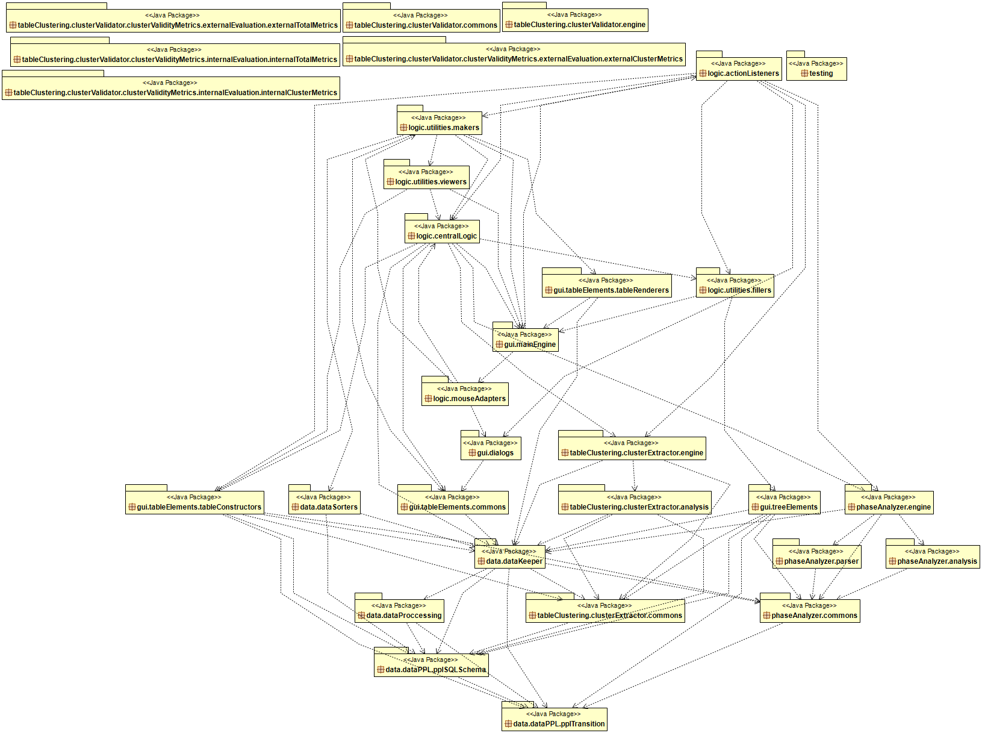
God Class – Source

Slide 11
Testing
Implements Serializable:
Vertical Cuts, creating a trace not just of what the user sees, but all details behind it.
Eight test cases, one test parser, one test suite.
Using Assert Bytes to compare and validate the original version of the project with the refactored one.

Slide 12
Code Style
Coding Style agreed upon:
Maximum 25 Lines per every Method.
Abstract Class holds all common code between implementing classes, other classes only know only it as a type and its Factory as the only way of making Concrete Classes.
Used Naming Conventions.

Slide 13
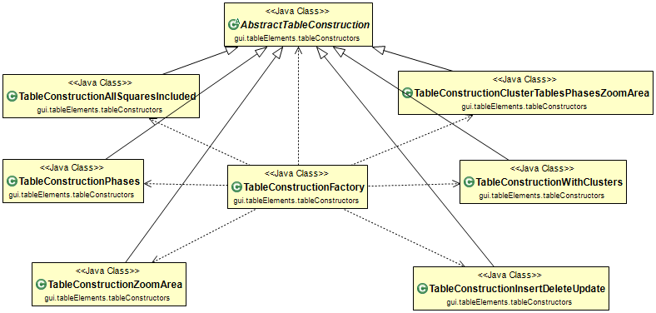
Code Style – Gui

Slide 14
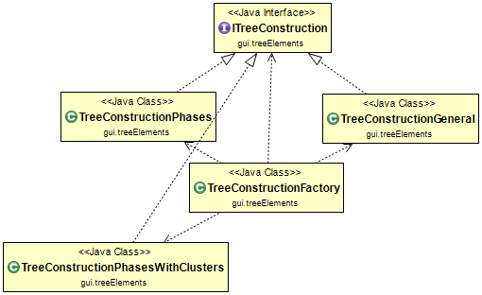
Code Style – Gui

Slide 15
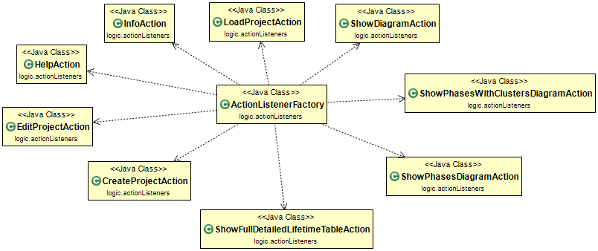
Code Style – Logic

Slide 16
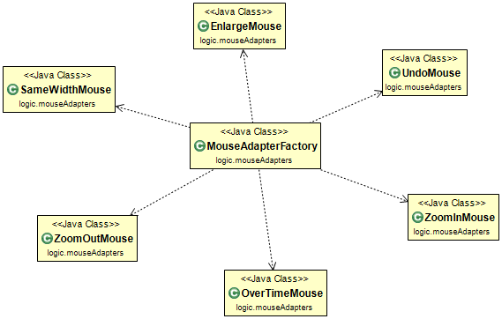
Code Style – Logic

Slide 17
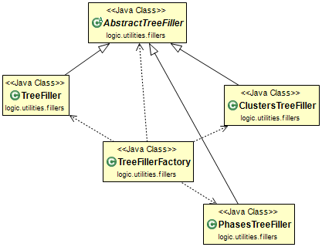
Code Style – Logic

Slide 18
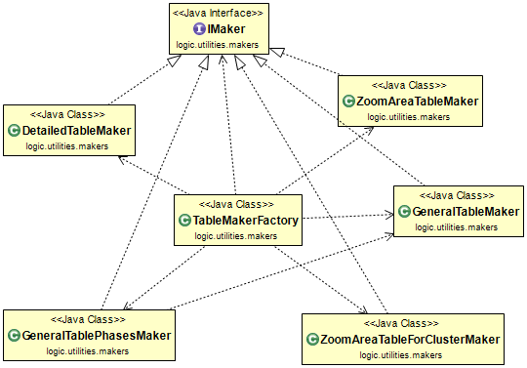
Code Style – Logic

Slide 19
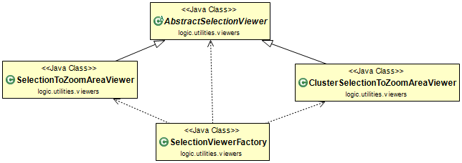
Code Style – Logic

Slide 20
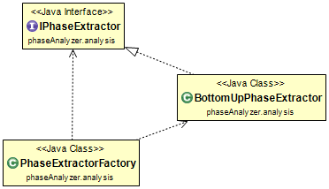
Code Style – Phases

Slide 21
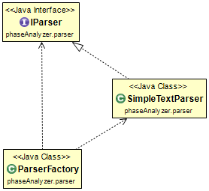
Code Style – Phases

Slide 22
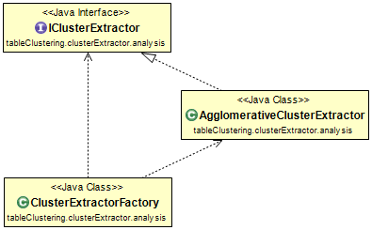
Code Style – Tables

Slide 23
Summarising
Pair Programming:
Although initially weary of it, the positives of pair programming are clear to us now.
Multiple ideas for the same thing, thus the ability to decide on the best one.
Splitting the workload when necessary, but also working side by side to catch mistakes as they happen.
Easier and enjoyable debugging.

Slide 24
Summarising
Key Figures:
God Class Gui smaller by 90%.
Up to 20 Classes merged with others, or removed as dead code.
Up to 40 Logic Classes extracted, grouped together and wrapped with abstractions.
Over 100 variables renamed, one by one, to adhere to naming conventions.

Slide 25
Thank you for your attention.
Anargyros Katsoulieris, 402
Konstantinos Leventos, 405

